Slide 1

www.minileaguemate.com

Slide 2

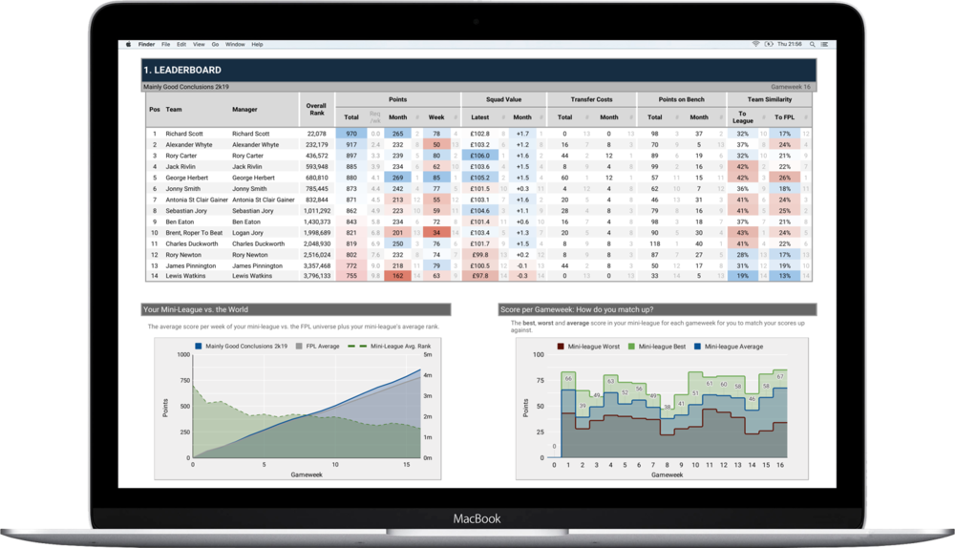
What is Mini League Mate?
Mini League Mate is an email newsletter just for your Fantasy Premier League mini-league
It is sent after every gameweek with your league’s stats, charts, leaderboards and more.
We extract everything you could imagine to create talking points and bragging rights to keep you entertained in between gameweeks.

Slide 3

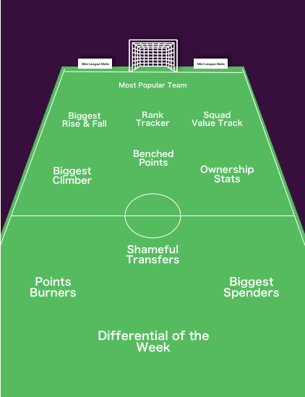
There’s a wealth of tools and dashboards an FPL manager can use to get a leg up in choosing the right players at the right time.
As FPL addicts ourselves, we know that the social element of the game is what really keeps the passion alive. Our service comprises of two products.
Dossier: A detailed breakdown of the Gameweek just gone and the season so far, emailed as a PDF to any manager who signs up.
Deadline Day: Right after the GW deadline passes, an email showing your league’s transfers in and out, captains and template team.
What is included?

Slide 4

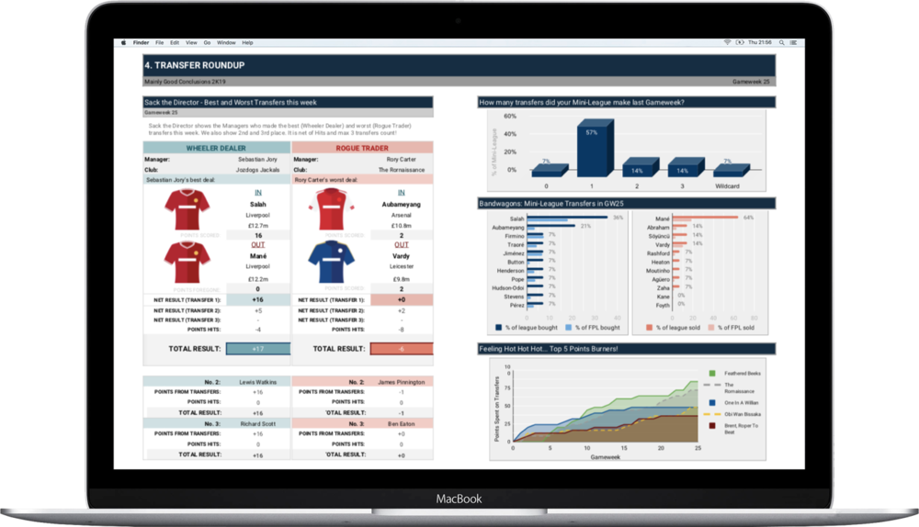
The Gameweek Dossier
Go deeper than who got the most points or who’s currently winning.
The Gameweek Dossier provides analytics you can’t see in the FPL app.
Rather than drown you in stats, we’ve carefully selected the most important metrics you can’t get by just looking through your mini-league.
Much like other people’s dreams, we know you don’t care about other people’s stats, so we made it very easy to see your own and how you stack up in your league.

Slide 5
Frequently Asked Questions?
Does everyone in the mini-league have to sign up?
Not at all. You can share Mini League Mate however you want, whether that’s over WhatsApp, forwarding the email or sharing on social but you might find it easier in the long run for everyone interested to have it sent to their emails to save you the hassle.
What stats exactly will we be emailed?
Check out the feature list above or start a free trial to see it in action tailored for your league. We’re pretty sure you won’t be disappointed.
Does Mini League Mate help me improve my FPL team?
It helps you see how you have gone wrong in relation to the people you play FPL against, gives you specific details on the past gameweek and lets you see how your league compares with others. If that helps, then yes
Can I sign up with a head-to-head league?
Unfortunately we don’t support H2H leagues yet but watch this space.
When do we get the GW Dossiers?
Usually 1-2 days after the Gameweek ends, so if you sign up in the window in between Gameweeks.
Your League. Your Mates.
Your Inbox.

